Slide 1
Agile Cricket

Slide 2
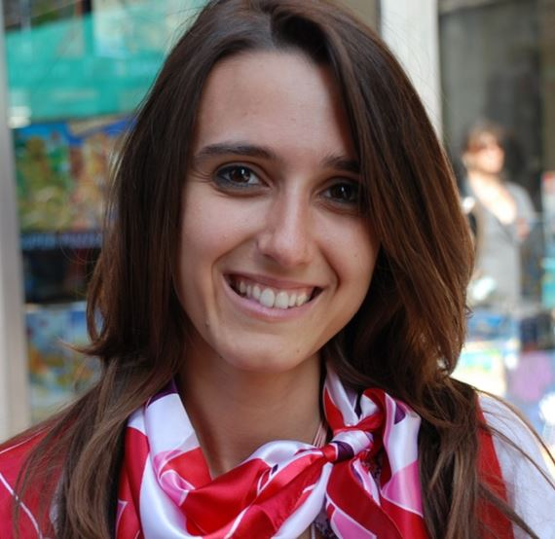
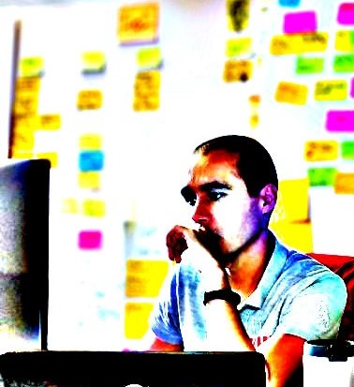
Raluca Mitan
Rade Zivanovic

Slide 3
Daily
Standups

Slide 4
Daily
Standups
Fast
Efficient
Notes:
How a typical daily should look like

Slide 5
....................................................................
Daily
Standups
Notes:
- A person goes on talking

Slide 6
@$%*#!
....................................................................
Daily
Standups
Notes:
People slowly getting bored

Slide 7
@$%*#!
....................................................................
Daily
Standups
&#*$@!
Notes:
More people bored

Slide 8
&#*$@!
%$*&#!
@$%*#!
@$%*#!
....................................................................
Daily
Standups
&#*$@!
@$%*#!
&#*$@!
&#*$@!
%$*&#!
Notes:
everyone’s bored

Slide 9
Notes:
Blogger

Slide 10
Notes:
Chuck Noris/superman
no obstacles ever
look out for team not reaching their sprint goal, but in dailies no problems

Slide 11
Notes:
Broken record/tape
generic info:
I fixed a bug and worked on a US, going to attend some meetings…

Slide 12
Notes:
Raluca:
Bird watcher
no eye contact or stares at SM/PO/manager
Hint: pay attention to new-joiners
how would it feel if you did that in while trying to follow this presentation?
body language is an important aspect of communication

Slide 13
( )
Notes:
Mr/Mrs Parenthesis
problem-solving in daily, interrupting others
important to notice we all act this way sometimes
people don’t like being told off, so through a game this can be more playful and acceptable

Slide 14
Daily
Standups
Fast
Efficient
Fun
Notes:
using personas we came up with a GAME!

Slide 15
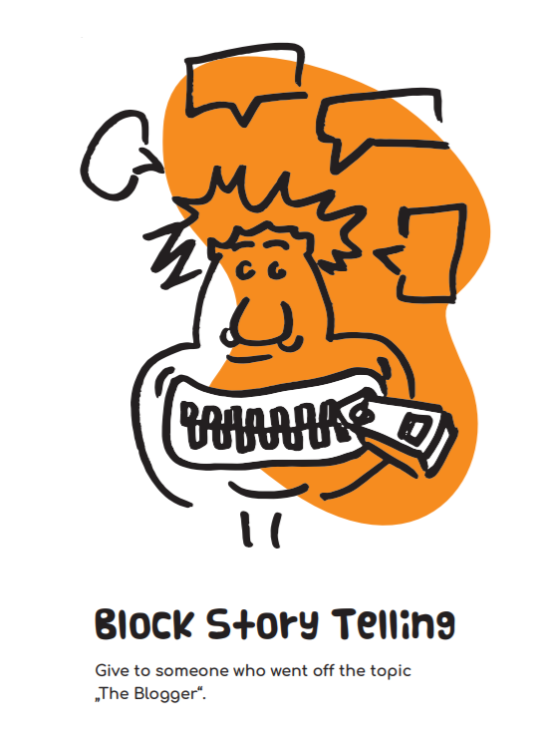
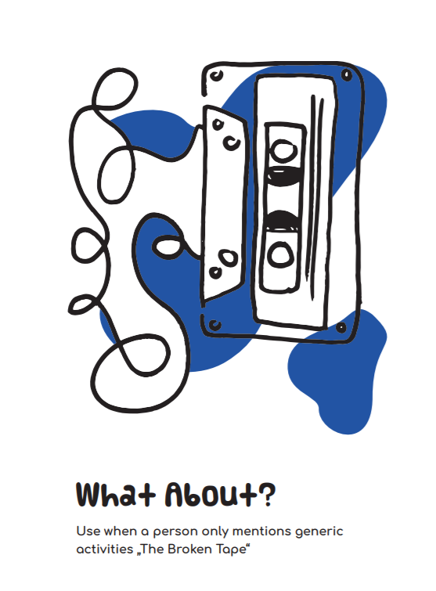
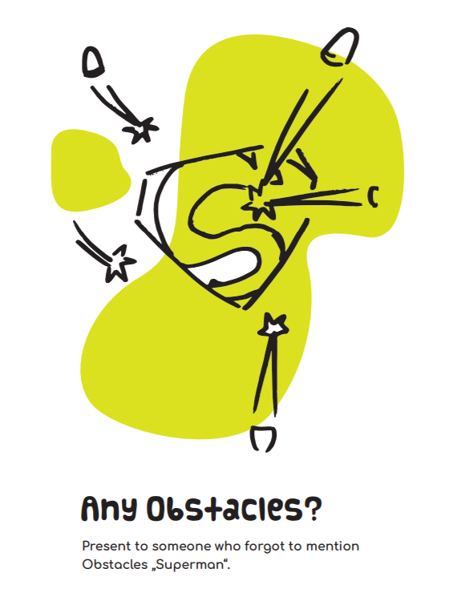
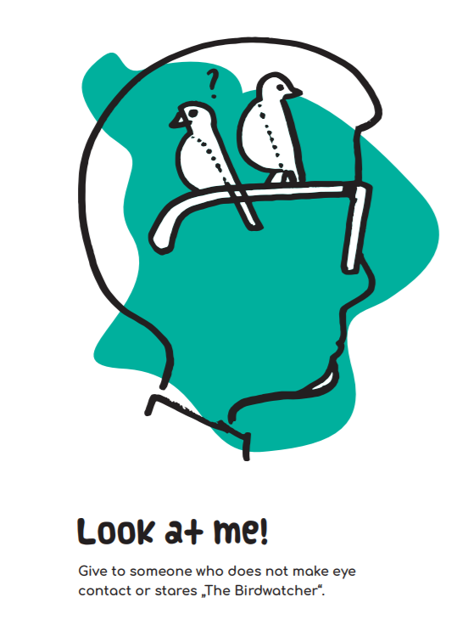
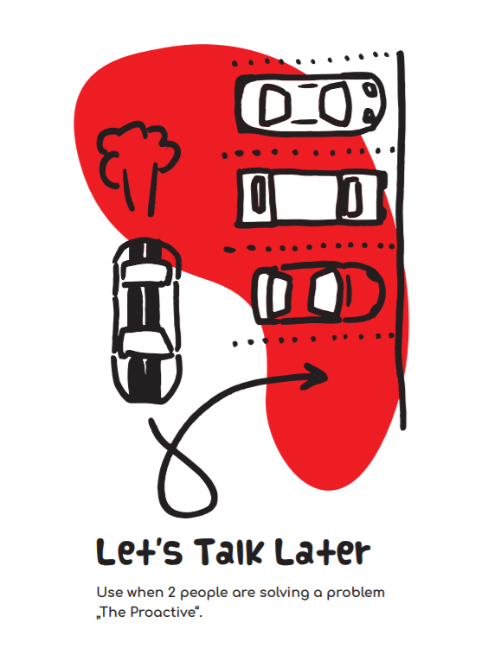
Notes:
5 cards for now
connection to personas

Slide 16
....................................................................
Daily
Standups
Notes:
explain how game works

Slide 17
....................................................................
Daily
Standups
Notes:
Rade
showing card

Slide 18
Sorry
Daily
Standups
Notes:
sorry, my bad

Slide 19
Daily
Standups
Notes:
Rade:
refocusing to the meeting

Slide 20
Let’s Play!
Notes:
and now it’s your turn!

Slide 21
Let’s Play!
6 Groups
each person gets instructions on how they should act
each person says what they did, going to do, impediments…
the goal is to play the game, not figuring out the instructions
Notes:
split into groups of 10 people
You will get 5 cards
one extra sheet of paper with instructions on how to act, because you might not be encountering these exact disfunction here and now
Go through the usual 3 questions, improvise, or repeat something from your recent dailies

Slide 22
Suggest to people to discuss between themselves, after the meeting
Ask a someone to be more specific
To remind someone to mentions obstacles
Remind people to look at each other
Call to attention that the person is sidetracking the meeting
Notes:
This cheat-sheet will be on the screen in case you need a reminder

Slide 23
Thoughts?
Notes:
Rade:
Now discuss in your team
what have you noticed
what worked/has not worked
did you figure out who was channeling which persona…

Slide 24
Findings
Notes:
feedback we’ve already received from different teams

Slide 25
Findings
Made daily meeting more attractive

Slide 26
Findings
Made daily meeting more attractive
Starting with too many cards was confusing
Notes:
- Too many cards was a distraction from the daily, it was hard to keep all of them in mind…

Slide 27
Findings
Made daily meeting more attractive
Starting with too many cards was confusing
The team members were happy that they were correcting each other, and not being schooled by the agile coach
Notes:
This could be a first step into self-organization for some teams

Slide 28
Findings
Made daily meeting more attractive
Starting with too many cards was confusing
The team members were happy that they were correcting each other, and not being schooled by the agile coach
A more experienced team thought the cards were more overhead and didn’t use it for too long
Notes:
We had different reactions from different teams
One of the experienced team found it fun to introduce variety into the routine

Slide 29
Findings
Made daily meeting more attractive
Starting with too many cards was confusing
The team members were happy that they were correcting each other, and not being schooled by the agile coach
A more experienced team thought the cards were more overhead and didn’t use it for too long
Undercover training
Notes:
An added bonus

Slide 30
Findings
Made daily meeting more attractive
Starting with too many cards was confusing
The team members were happy that they were correcting each other, and not being schooled by the agile coach
A more experienced team thought the cards were more overhead and didn’t use it for too long
Undercover training
Everyone said they paid more attention to what the colleagues were saying just so they could “catch” them
Notes:
this is the point of the daily, to hear what everyone else on the team is working on now

Slide 31
Ideas
Notes:
- Based on the feedback we received so far, here are some ideas for future improvements

Slide 32
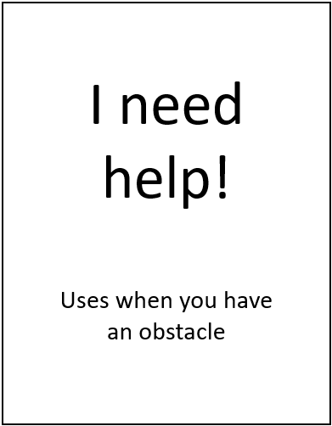
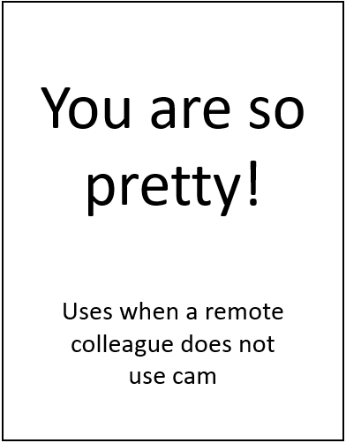
Ideas
More cards for other situations
Notes:
no design yet for these cards
Late/missing dailies
Make it very obvious that someone is asking for help, harder to ignore
Remote teams, someone not sharing their video

Slide 33
Ideas
More cards for other situations
Different play rules
Notes:
One idea SM/one team member to introduce, team takes over
split cards across the team so no everyone has all the cards – improve team listening and focusing

Slide 34
Ideas
More cards for other situations
Different play rules
Gamification
+1
Notes:
keeping score, positive/negative points

Slide 35
Ideas
14
More cards for other situations
Different play rules
Gamification
Observing the progress of individuals and teams
9 +1 = 10!
Notes:
- Follow progress over time

Slide 36
agilecricket.com
Notes:
open source, licensed under Creative Commons Attribution-NonCommercial-ShareAlike 4.0 International License
download
Improvements will be published there
Interesting articles on everything agile

Slide 37
Special Thanks to:
André (Deco) Verri – game mechanics
Jesus Exposito Marquina – artwork
Stefan Kojic – cards design
Robert Vorlicsek – print preparation
Notes:
we discovered it involves lots of work to develop a game
These are the folks that helped us bring it to life

Slide 38
Special Thanks to:
Agile Stationery
Devika Gibbs
Simon Gibbs
For the cards you are using today.
https://agilestationery.co.uk/
Notes:
- Printed with support of these folks

Slide 39
Raluca Mitan
mitan.office@yahoo.com
Rade Zivanovic
rade.zvanovic@gmail.com
agilecricket.com
Reach out to us to let us know how it went with your team(s)
What have you used the most?
What was missing?
Notes:
get in touch with your ideas
We are curious to hear
what your experience while using them in your daily was
how it went
what is still missing/what haven’t you used at all…
Bigger sample will help us get more accurate picture of what real teams out there need

Slide 40
Raluca Mitan
mitan.office@yahoo.com
Rade Zivanovic
rade.zvanovic@gmail.com
agilecricket.com
Thank You!
Notes:
Thank you for being here, for participating and for trying out the game
We hope you had some fun and will try it out in your next daily ☺

